Slide 1
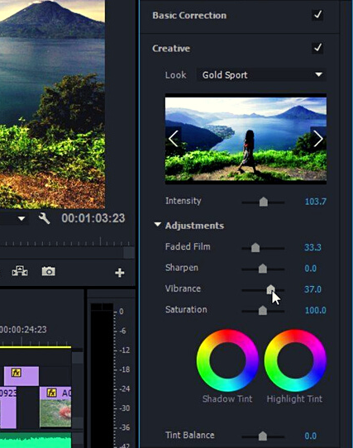

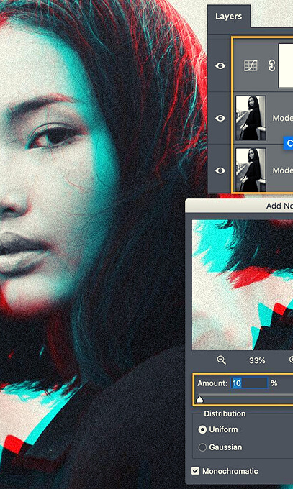
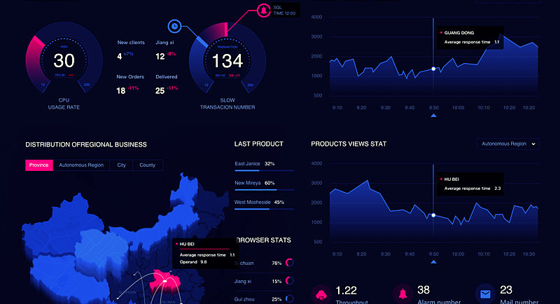
NEW
ERA
OF
CREATIVITY
DIGITAL BOND COMPANY PROFILE | 20201
01
Notes:
Design Story:
All icons and characters will be separated from their background and used accordingly to fill white gaps.
Fill white gaps with the logo icon (atomic triangle) faded or any atomic structure that shows connection.

Slide 2


CREATIVE COMMITMENT
We are a bonded family that mix and match creativity and commitment to help brands go beyond the limit. Bonders are a blend of cheerful, uprising and creative peeps working to deliver outstanding services. We are committed and loyalty runs in the veins; when we are put together our results blow minds.
DIGITAL BOND CREATION
DIGITAL BOND COMPANY PROFILE | 2021
CONCEPT OF "BONDERS"
Bonders speak concepts not titles. Bonding creativity, commitment and you.
02
Notes:
Story design:
1. The guy + the planet and the connection between them will be separated from their background.
2. Fill white gaps with the logo icon (atomic triangle) faded or any atomic structure that shows connection.

Slide 3
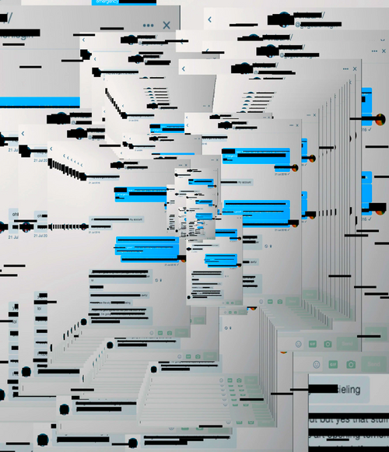
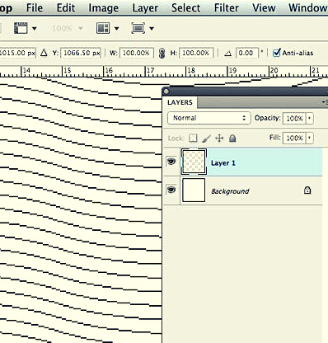
DIGITAL BOND COMPANY PROFILE | 2021
OUR KIT
Notes:
Story Design:
Background needs to be filled with icons that represents creativity and commitment.
Ex: Lamp, social media icons etc…

Slide 4
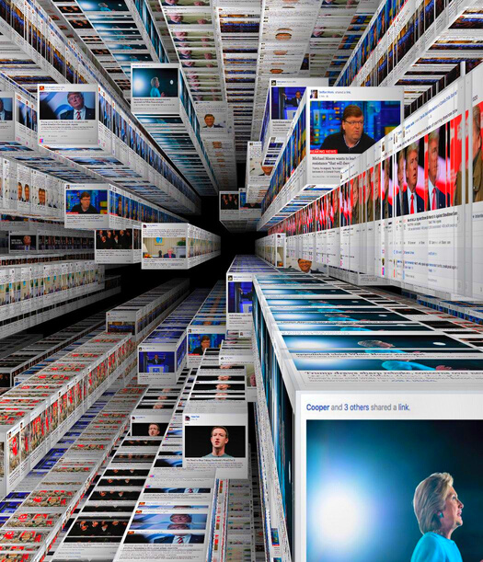
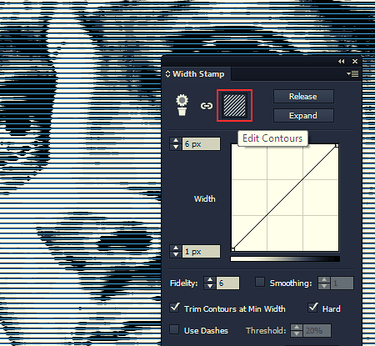
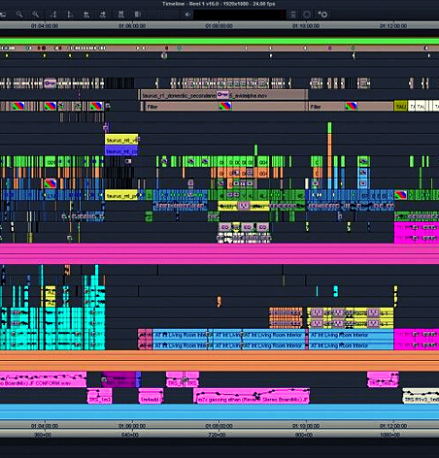
BRANDING
All the way from strategy to implementation; our team studies your brand to bond it with the best way to your audience.
Your brand needs distinguishing and a place in the market With our various branding techniques we guarantee you to be the chitchat
DIGITAL BOND COMPANY PROFILE | 2021
OUR KIT
SOCIAL MEDIA
Bonding you with an outstanding online presence takes a joker, one who got the hang of it; and is creative above all. The ability to keep up and cope with the everyday changes is what it takes to make a brand digitally shine.
INFLUENCERS MARKETING
& Digital pr
Our main aim is to bond with and for; bonding you with figures for your image to stand out
Notes:
Story design:
Include more depth to the slide, aka different dimensions, some photos might be putted diagonally, insert shadow etc…

Slide 5
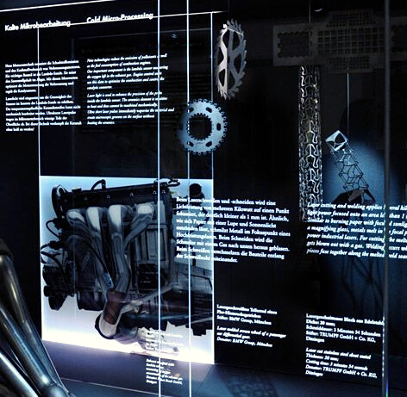
VIDEO PRODUCTION
Bonding artists and visuals to
execute results that will astonish you.
WEB DEVELOPMENT
The extra shot your brand needed. Bonding design and commitment to produce a
uniquely designed website to boost your business and be visually appealing, responsive, and user friendly.
DIGITAL BOND COMPANY PROFILE | 2021
OUR KIT
MOBILE APPLICATIONS
Bonding the creativity within the numerically oriented minds on our team to develop effortlessly easy and accessible apps; with an out of this world user experience.
SMS CAMPAIGNS
SMS campaigns will never be last season.
These campaigns helps in exposure and maintaining loyalty. We are here to discover your bond with the three different SMS techniques and how they can serve you.
05
Notes:
Story Design:
Background needs to be filled with icons that represents creativity and commitment.
Ex: Lamp, social media icons etc…

Slide 6






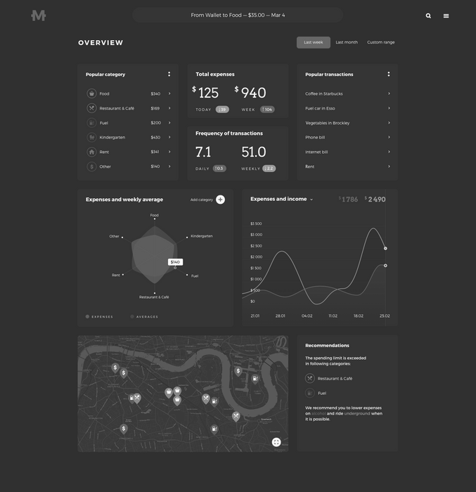







06
Our Clients
DIGITAL BOND COMPANY PROFILE | 2021
Notes:
Story design:
Add some artistic aspect to it.
Ex: Build a shape with the logos or spread them nicely all over the slide, also if you’d like to include photos, feel free.

Slide 7







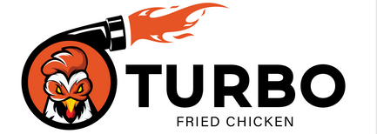






07
Our Clients
DIGITAL BOND COMPANY PROFILE | 2021
Notes:
Story design:
Add some artistic aspect to it.
Ex: Build a shape with the logos or spread them nicely all over the slide.

Slide 8



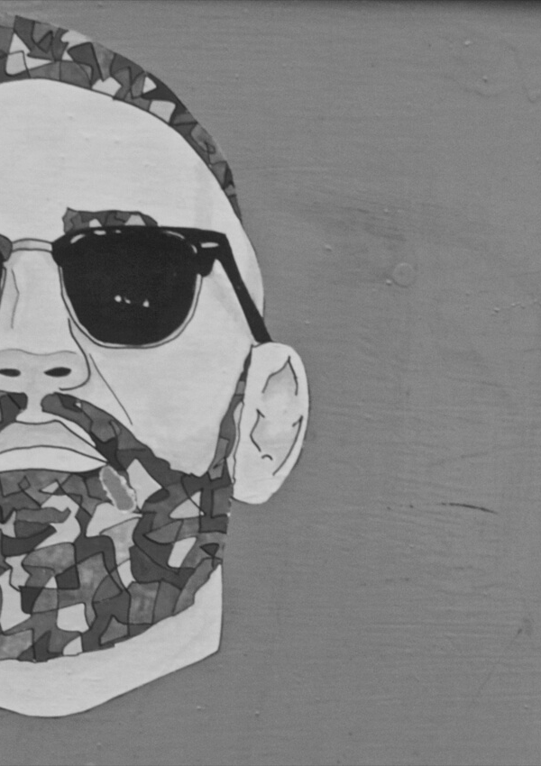
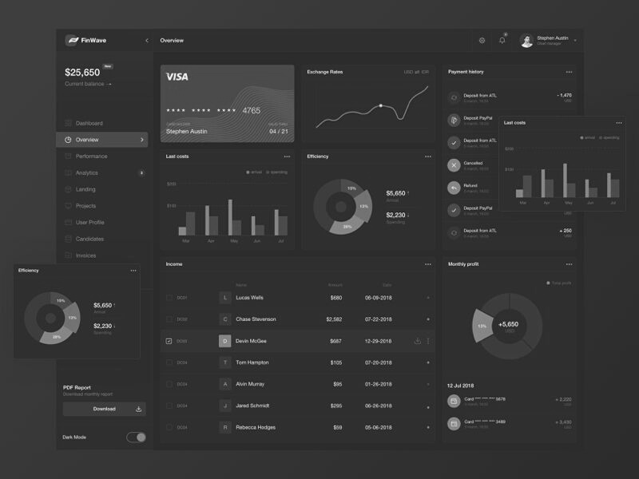


08
Our Partners
DIGITAL BOND COMPANY PROFILE | 2021
Notes:
Story design:
Add some artistic aspect to it.
Ex: Build a shape with the logos or spread them nicely all over the slide.

Slide 9

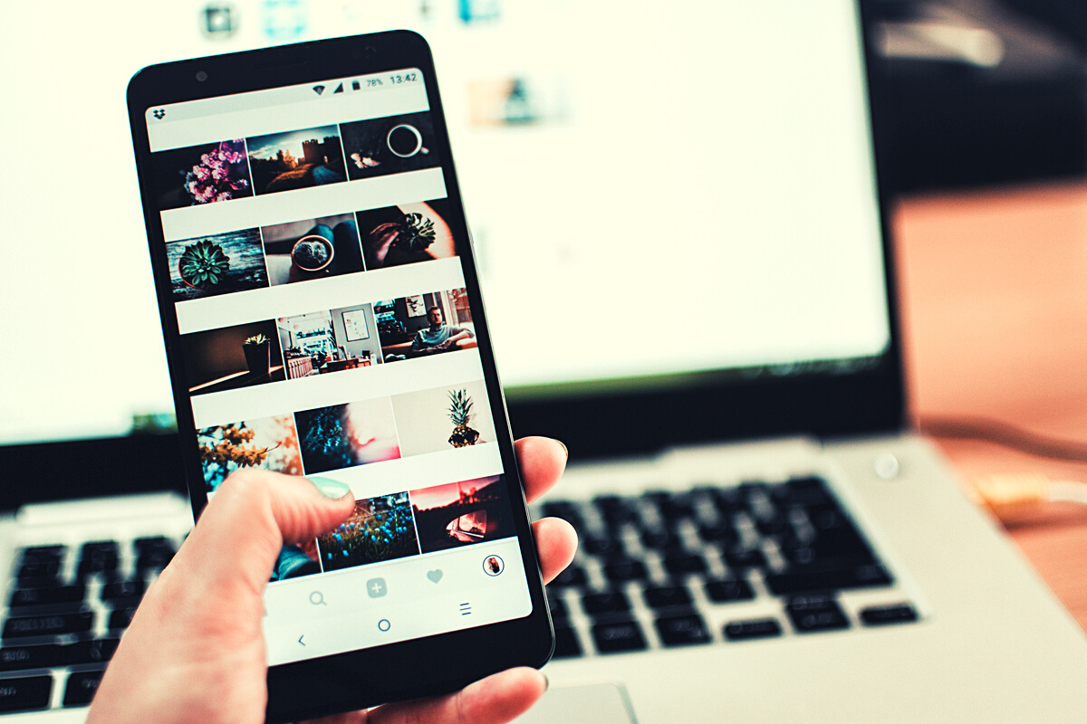
SOCIAL MEDIA
DIGITAL BOND COMPANY PROFILE | 2021
Notes:
Story Design:
Background needs to be filled with icons that represents creativity and commitment.
Ex: Lamp, social media icons etc…

Slide 10
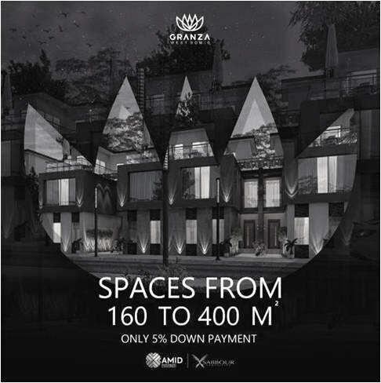
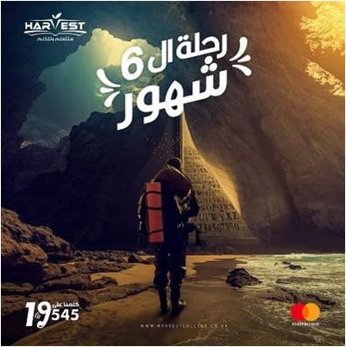

Work samples
SOCIAL MEDIA
DIGITAL BOND COMPANY PROFILE | 2021
10
Notes:
Story design:
Include more depth to the slide, aka different dimensions, some photos might be putted diagonally, insert shadow etc…

Slide 11
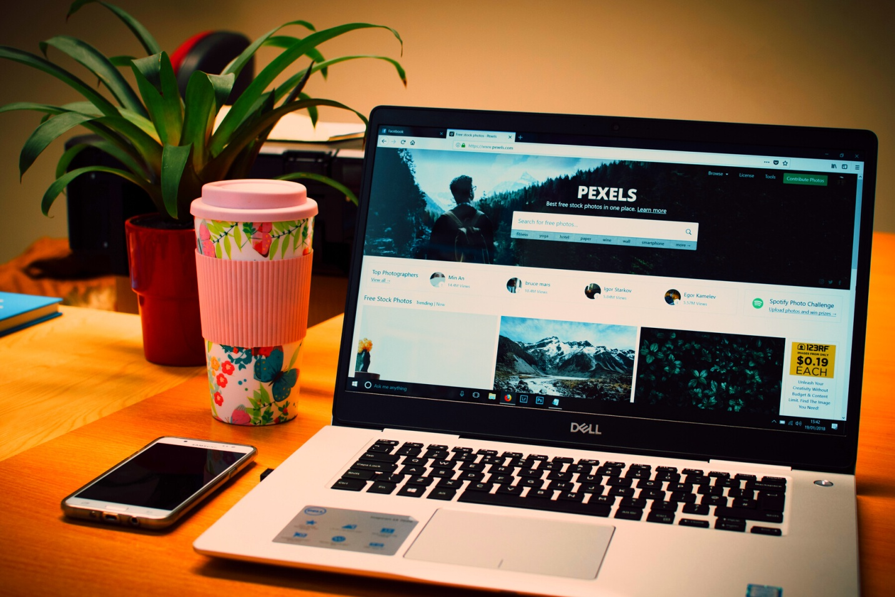

DIGITAL BOND COMPANY PROFILE | 2021
WEBSITES
Notes:
Story Design:
Background needs to be filled with icons that represents creativity and commitment.
Ex: Lamp, social media icons etc…

Slide 12

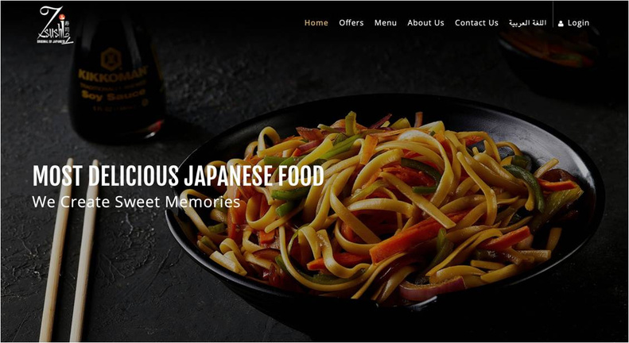
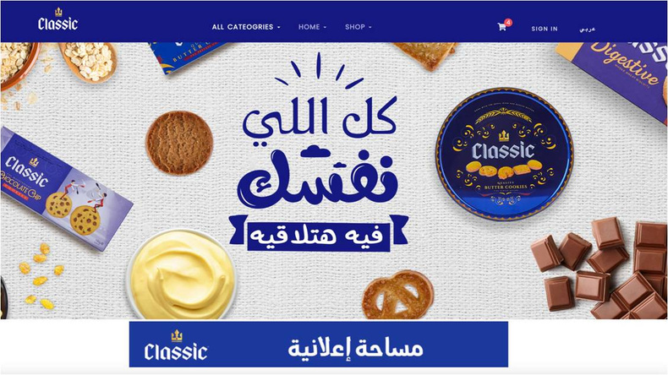

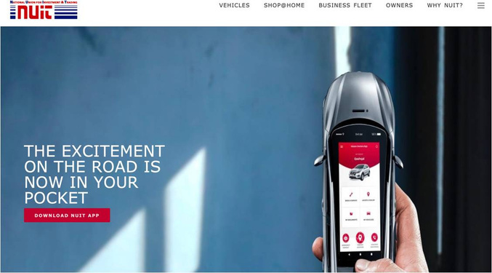
Work samples
WEBSITES
DIGITAL BOND COMPANY PROFILE | 2021
12
Notes:
Story design:
Include more depth to the slide, aka different dimensions, some photos might be putted diagonally, insert shadow etc…
Mess around with the laptop/ Ipad/ computer, include more samples with different sizes.

Slide 13


DIGITAL BOND COMPANY PROFILE | 2021
MOBILE APPLICATIONS
Notes:
Story Design:
Background needs to be filled with icons that represents creativity and commitment.
Ex: Lamp, social media icons etc…

Slide 14




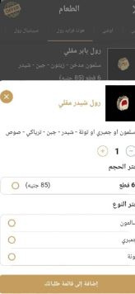
14
DIGITAL BOND COMPANY PROFILE | 2021
Work samples
MOBILE APPLICATIONS
Notes:
Story design:
Include more depth to the slide, aka different dimensions, some photos might be putted diagonally, insert shadow etc…
Move the phones around (Zi sushi landing page should be the main)
More samples should be included form other clients (Same idea)

Slide 15
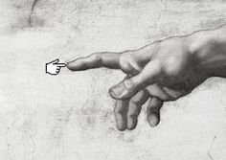



Find Us
DIGITAL BOND COMPANY PROFILE | 2021
@DigitalBondMena
@digitalbondmena
@digital-bond-80956720a
Online
15
Notes:
Story Design:
We all agreed that Adam’s creation photo is nice, so try to keep it, you can change it’s background

Slide 16
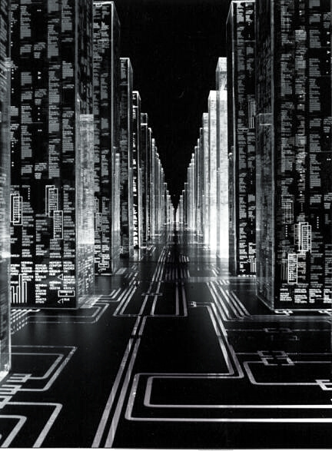
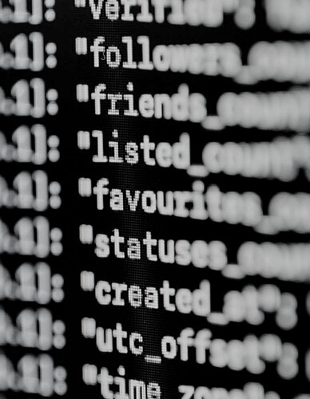
Let's Bond!
Email
bonder@digitalbondmena.com
Mobile
0102-155-1322
Address
11 Al Israa street, El Mohandseen, Giza Governorate, Egypt
Website
digitalbondmena.com
Notes:
Story Design:
All pictures here will be removed, find any other pictures that represents the digital world.
Kindly, don’t forget the icons in the background.

